Slide 1
Skills Bootcamp Classroom Rules
Be on time: Just like in a physical classroom, it's important to be punctual for your online class. Log in to the virtual classroom a few minutes before the class starts.
Turn Cameras on: In order to maximise your learning studies show that being able to see your peers and your tutor being able to see you can increase motivations and retention, therefore we ask to keep your cameras on.
Attend all classes: In order to be successful in your bootcamp studies you need to attend all live sessions, therefore you should prioritise and make time for these sessions.
Avoid distractions: Turn off your phone notifications, close any other unnecessary tabs, and focus solely on the class.
Participate actively: It's important to be an active participant in the class. Ask questions, answer questions, and participate in discussions.
Use proper language and tone: Use respectful language and tone when communicating with your classmates and instructor. Avoid using slang or inappropriate language.
Respect others' opinions: Be respectful of others' opinions, even if they differ from your own. Avoid making negative comments or attacking others.
Follow the instructor's guidelines: Follow the instructor's guidelines, such as submitting assignments on time.
Be polite: Be polite and respectful to everyone in the class, including the instructor, classmates, and guest speakers.
Dress appropriately: Even though you are not in a physical classroom, it's important to dress appropriately. Dress as if you were going to a face-to-face class.
Use appropriate technology: Ensure that you have the necessary equipment, such as a reliable internet connection, a microphone, and a webcam, and that they are in good working condition.

Slide 2
Software Developer Bootcamp
Unit 2 – Digital Processes and Services
Week 5A

Slide 3
Objectives
Following this session, you should be able to:
Understanding the Core Phases of RAD Methodology
Differentiate Between RAD and Traditional Development Methodologies
Apply RAD Phases to a Real-world Scenario

Slide 4
Core Phases of RAD Methodology

Slide 5

Requirements Gathering
The first phase of RAD methodology is Requirements Gathering. This involves identifying the needs of the customer and understanding the scope of the project.
The requirements should be documented in detail and agreed upon by both the customer and the development team.

Slide 6

Design
The second phase of RAD methodology is Design. This involves creating a blueprint for the project, which includes the architecture, user interface, and database design.
The design should be reviewed and approved by the customer before proceeding to the next phase.

Slide 7

Development
The third phase of RAD methodology is Development. This involves building the application according to the design specifications.
The development team should use the latest technologies and best practices to ensure the application is robust and secure.

Slide 8

Testing
The fourth phase of RAD methodology is Testing. This involves testing the application to ensure it meets the customer's requirements and is of the highest quality.
The testing should include unit tests, integration tests, and user acceptance tests to ensure the application is bug-free and ready for deployment.

Slide 9

Deployment
The fifth phase of RAD methodology is Deployment. This involves releasing the application to the customer and making it available to the public.
The deployment should be done in a controlled manner to ensure the application is stable and secure.

Slide 10

Maintenance
The sixth phase of RAD methodology is Maintenance. This involves keeping the application up-to-date with the latest features and bug fixes.
The maintenance should be done on a regular basis to ensure the application is secure and running smoothly.

Slide 11

Advantages of RAD
RAD methodology has several advantages over traditional software development methods.
It is faster, more cost-effective, and allows for more flexibility in the development process.

Slide 12

Disadvantages of RAD
RAD methodology also has some drawbacks.
It can be difficult to manage the development process, and the quality of the application may suffer if the requirements are not well-defined.

Slide 13

Conclusion
In conclusion, RAD methodology is a powerful tool for developing applications quickly and efficiently.
The benefits of RAD outweigh the drawbacks, making it an ideal choice for many software development projects.

Slide 14
Difference Between RAD and Traditional Development Methodogy

Slide 15
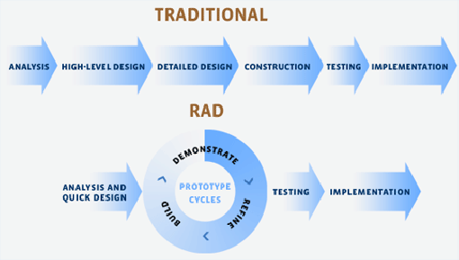
RAD vs Traditional?

Slide 16

What is RAD?
RAD is a software development methodology that focuses on rapid prototyping and rapid application development.
It is an iterative process that allows for quick changes and modifications to be made to the software.
RAD is often used when the requirements of the software are not known in advance or when the development process needs to be completed quickly.

Slide 17

What is Traditional Development?
Traditional software development is a more structured approach to software development.
It follows a linear process, with each step building on the previous one.
It is often used when the requirements of the software are known in advance and the development process can be completed in a more predictable manner.

Slide 18

Advantages of RAD
RAD is a great choice for projects that require quick turnaround times.
It is also a great choice for projects that require frequent changes and modifications.
RAD is also a great choice for projects that require a lot of user feedback and testing.

Slide 19

Disadvantages of RAD
RAD can be difficult to manage, as it requires a lot of user feedback and testing.
It can also be difficult to ensure that the software meets all of the requirements.
RAD can also be more expensive than traditional software development, as it requires more resources and time.

Slide 20

Advantages of Traditional Development
Traditional software development is a great choice for projects that require a more structured approach.
It is also a great choice for projects that require a predictable timeline and budget.
Traditional software development is also a great choice for projects that require a high level of quality assurance.

Slide 21

Disadvantages of Traditional Development
Traditional software development can be difficult to manage, as it requires a lot of planning and documentation.
It can also be difficult to make changes and modifications to the software once it has been developed.
Traditional software development can also be more expensive than RAD, as it requires more resources and time.

Slide 22

Which Methodology is Right for You?
The right development methodology for your project will depend on your specific needs and requirements.
If you need a quick turnaround time and frequent changes, RAD may be the right choice.
If you need a more structured approach and a predictable timeline and budget, traditional software development may be the right choice.

Slide 23

Conclusion
RAD and traditional software development are both valid development methodologies.
The right choice for your project will depend on your specific needs and requirements.
It is important to consider the pros and cons of each methodology before making a decision.

Slide 24
RAD Phases to a Real-world Scenario

Slide 25
What is RAD?
Rapid Application Development (RAD) is a software development methodology that focuses on quickly building a working prototype of a software application.
It is used to reduce the time and cost of software development by breaking down the development process into smaller, more manageable chunks.

Slide 26

RAD Phases
RAD is typically broken down into four distinct phases: Requirements Gathering, Design, Implementation, and Testing.
Each phase is designed to help the development team quickly build a working prototype of the software application.

Slide 27

Requirements Gathering
The first phase of RAD is Requirements Gathering. This phase involves gathering information from stakeholders and users to determine the scope and requirements of the software application.
The goal of this phase is to ensure that the development team has a clear understanding of the project before they begin development.

Slide 28

Design
The second phase of RAD is Design. This phase involves creating a blueprint for the software application based on the requirements gathered in the first phase.
The goal of this phase is to ensure that the development team has a clear understanding of how the software application should be built before they begin development.

Slide 29

Implementation
The third phase of RAD is Implementation. This phase involves building a working prototype of the software application based on the design created in the second phase.
The goal of this phase is to ensure that the development team has a working prototype of the software application before they begin testing.

Slide 30
Testing
The fourth and final phase of RAD is Testing. This phase involves testing the software application to ensure that it meets the requirements gathered in the first phase.
The goal of this phase is to ensure that the software application is of high quality before it is released to the public.

Slide 31

Real-world Scenario
RAD can be used in a variety of real-world scenarios. For example, it can be used to quickly develop a prototype of a web application or mobile application.
RAD can also be used to quickly develop a prototype of a software application for a specific industry, such as healthcare or finance.

Slide 32
Benefits of RAD
RAD has many benefits, including reduced development time and cost, increased flexibility, and improved quality.
RAD also allows for rapid prototyping, which can help the development team quickly identify and address any issues before the software application is released to the public.

Slide 33

Conclusion
RAD is a powerful software development methodology that can be used to quickly develop a working prototype of a software application.
RAD can help reduce the time and cost of software development, while also improving the quality of the software application.

Slide 34
Another branch
You can provide another branch to your selection statement by using if-else.
When you use if-else you are saying:
“If this condition is True then do this. Else, do this.”
if this_is_true:
do this
else:
do this

Slide 35
An example of using else
The condition will check if the value of user is equal to the string "Elizabeth".
print("What’s your name?")
user = input()
if user == "Elizabeth":
print("Good morning Your Majesty")
else:
print("Hello", user)
The expression user == "Elizabeth" will evaluate to either True or False.
This is the if-block, i.e. the code that will be executed if the condition is True.
This is the else-block, i.e. the code that will be executed if the condition is False.
Only one of these blocks will be executed, depending on the value of the condition.

Slide 36
More branches!
You can provide further branches by using elif.
When you use if-elif-else you are saying:
“If this condition is True then do this. Else if this condition is True then do this. Else, do this.”
if this_is_true:
do this
elif this_is_true:
do this
else:
do this

Slide 37
An example of using elif
If the expression user == "Elizabeth" is evaluated to False.
print("What’s your name?")
user = input()
if user == "Elizabeth":
print("Good morning Your Majesty")
elif user == "Alan Sugar":
print("Good morning Sir")
else:
print("Hello", user)
The elif condition will check if the value of user is equal to the string "Alan Sugar".
If this is True, the elif-block will be executed.
The else-block will be executed if both conditions are False.
Only one of these blocks will be executed, depending on the value of the conditions.

Slide 38
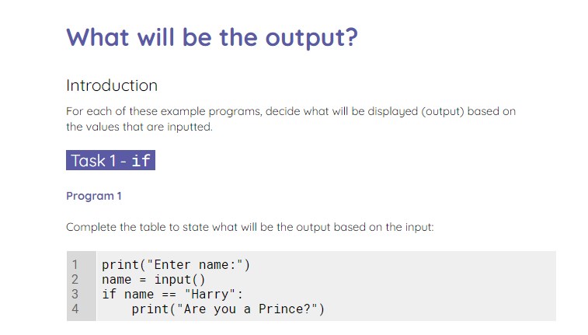
What will be the output?
Use the worksheet to decide what will be the output based on the input.
Notes:
A1 Worksheet – What will be the output_

Slide 39
Objectives
Following this session, you should be able to:
Understanding the Core Phases of RAD Methodology
Differentiate Between RAD and Traditional Development Methodologies
Apply RAD Phases to a Real-world Scenario

Slide 40

Questions?

Slide 41
Thank You

